Slide 1
QUADCOPTER POWER SAVING CLAW
Authors – Maitree Rawat*, Ujjwal Kumar, Satyam Priyam Roy

Slide 2
AIM OF RESEARCH
To maximize Flight time of a Quadcopter!

Slide 3

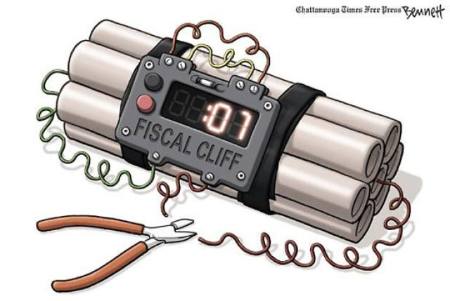
SITUATION-1 (SUSPICIOUS FINDINGS)
1) Carry the Item
2)High Speed

Slide 4

SITUATION-2 (TERRORISM)
Fly & Stay
2) Small in Size
3) Provide Info

Slide 5
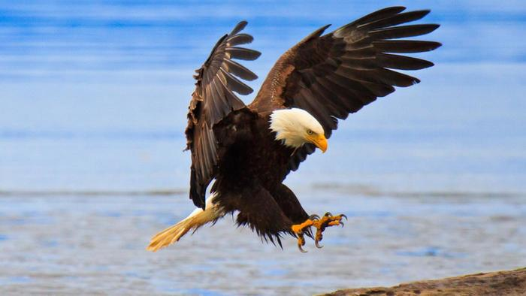
CONDENSING THE REQUIREMENTS
We needed something ……
Fly & Stay
Small Size
High Speed
Do not consume power
Carry
Transmit Information
Cheap

Slide 6
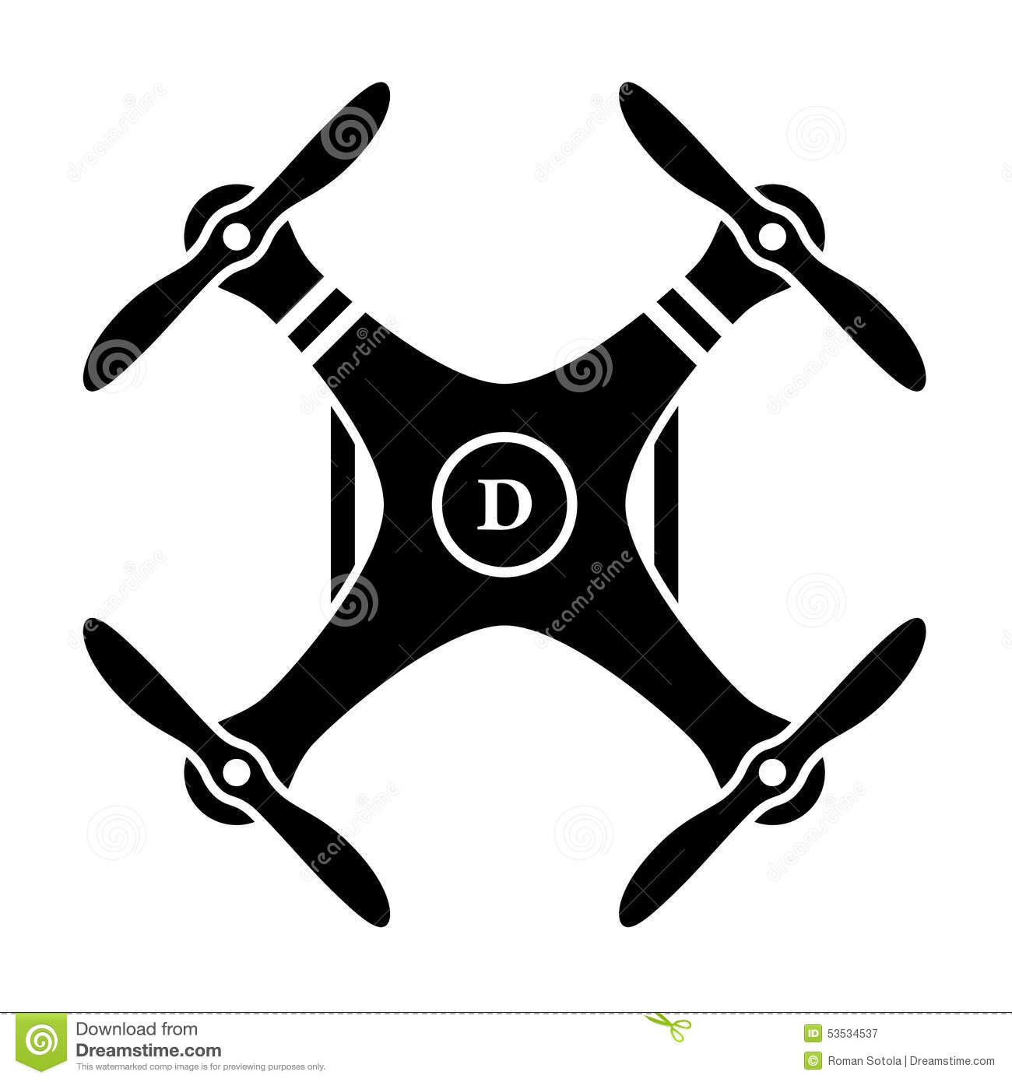


QUADCOPTERS
We needed something ……
Fly
Small Size
High Speed
Consume Less power
Carry
Transmit Information
Cheap

Slide 7

OBJECTIVES OF RESEARCH
To generate a maximum flight time of a Quadcopter by:-
creating a balanced robotic gripper that can fly like a bird to anywhere it wants to survey and grab a tree branch or a street light.
attaching Solar Panel to charge its battery

Slide 8
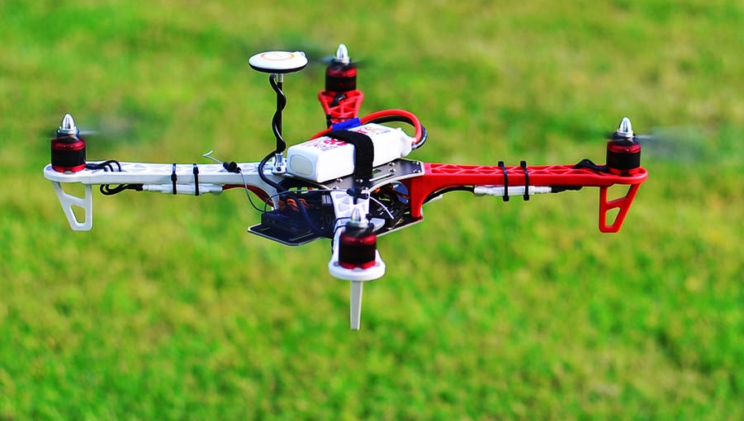
Introduction
Quadcopter , aerial vehicle operated to fly independently
Unmanned Aerial Vehicle (UAV)
Lifted and propelled by use of four motors
Generally is in X or + shape.
Powered by Lithium polymer chemistry based batteries

Slide 9
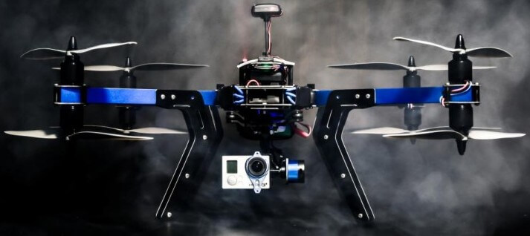
APPLICATIONS
Due to small size, quadcopters are cheaper and due to their mechanical simplicity.
Are controlled wirelessly .
Applications of Quadcopters are found in variety of fields :
Military and law enforcement
Research platform
Photography
Journalism
Art

Slide 10
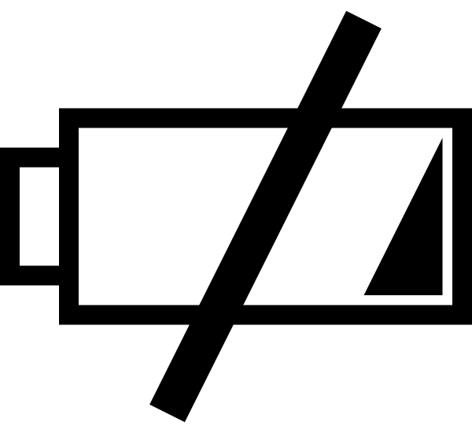
Battery drainage
BLDC motor consumes about 180 watts power.
Total power consumption is thus 4x180 watts = 720 watts.
The total flight time for a quadcopter with 5000 mAh battery of discharge rate 20C, 14.1 volts is approximately 20 to 35 minutes.
This flight time is not sufficient for long term operations.

Slide 11
Power consumption Chart

Slide 12

OUR RESEARCH
How can flight time be increased?
Plan A - Saving Power by attaching a claw
Plan B – Recharging Batteries using Solar Panels

Slide 13
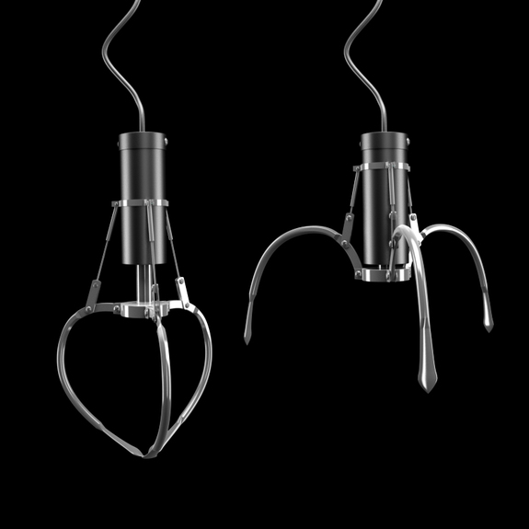
WHAT IS THE NEED OF CLAW?
Save the battery consumed by propellers in flying!
By adding a claw quads can :-
Carry Suspicious Items
Surveillance
Rescue Mission
Record and Transmit activity
Search
Messenger

Slide 14
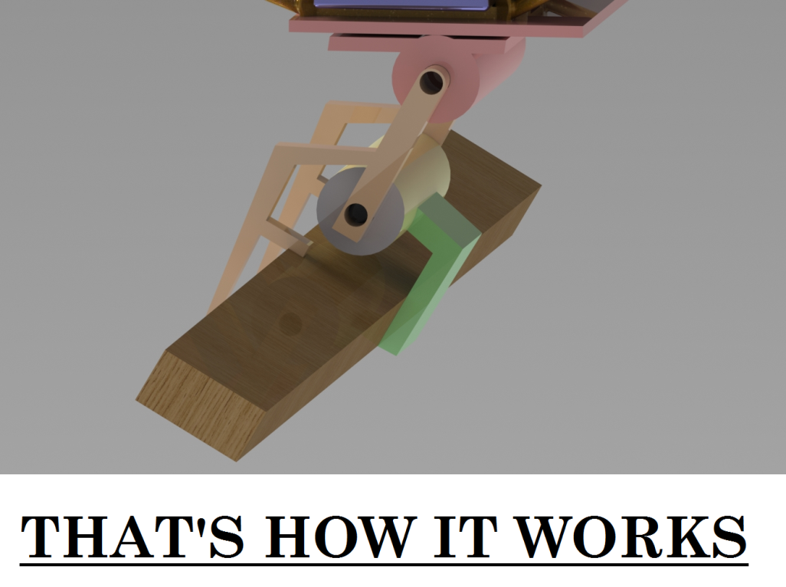
WORKING OVER PLAN -A
Attach a single axis robotic arm under aircraft where moment of inertia is zero.
Attach infrared proximity sensor to sense any bar .
Grabs the bar so rigidly that it cannot tip over to any side.
High torque servos with toothed grabber are used.

Slide 15
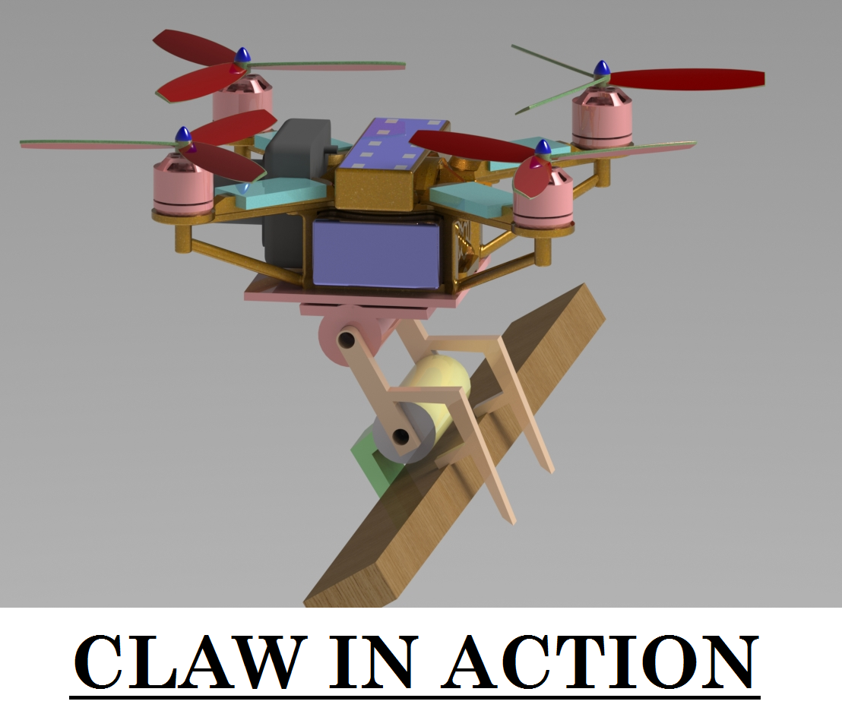

Slide 16
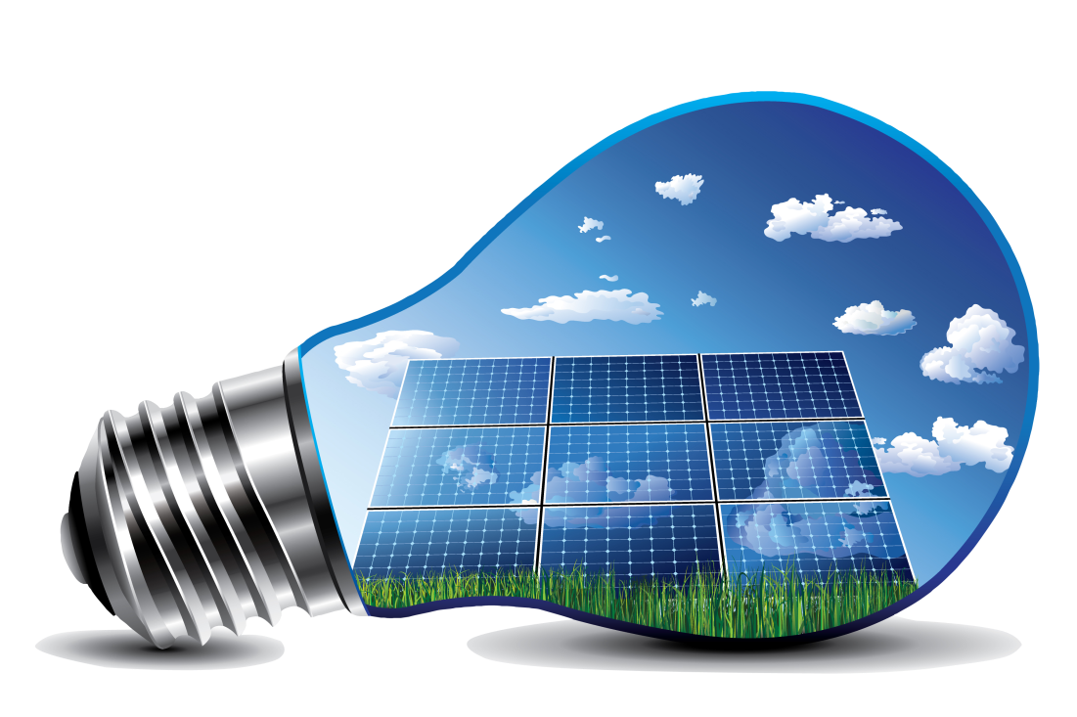
PLAN-B ADDITION OF SOLAR PANELS
Carbon frame is used , solar cells rest on Tree foam boards.
Each wing has 5 solar panels (7.2 volt / 100 Miliamp) arranged in parallel (7.2 volt / 500 Miliamp total)
Hooked 2 pair of wings in series (14.4 volt) then connected each pair in parallel (1000 Miliamp).
Charge the battery about 0.5 volts each time it landed (it sat in the sun about 15min).

Slide 17
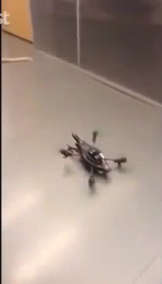

PRACTICALS

Slide 18
RESULTS
With Claw
Without Claw
POWER
time
time
POWER
Power Consumed During Flying
Power Consumed At Rest Position

Slide 19
OTHER REQUIREMENTS
Make it bigger :
Adding more rotors
Adding more batteries
Reducing frame weight
Custom ESC or Motors
Invert the motors
Addition of ducts around the rotor
Addition of contra-rotating rotors

Slide 20
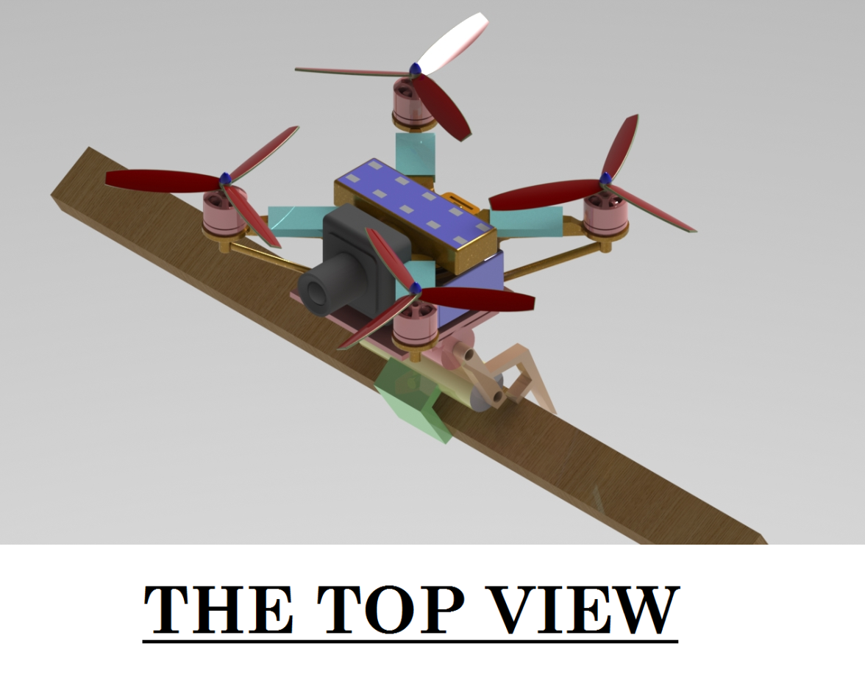
FUTURE PERSPECTIVES
Future perspectives of this research are:-
Increase in flight time upto 12 hours.
Equipped with more sensors to sense bomb
Will have the ability to climb
Will be more compact and cheap
Will have artificial intelligence
Will access internet
Have features like Voice Recognition
Increase in speed upto 500km/hr.

Slide 21

CONCLUSION

Slide 22
Thank you
Idea and research – Maitree Rawat*
Calculations and implementations– Ujjwal Kumar
Modelling and simulation– Satyam Priyam Roy
Graphic Era University
566/6, Clement town, Bell Road
Dehradun - 248001

